Slide 1
HIGHER EDUCATION AND THE ELECTION, AND AN UPDATE ON THE RENTERS (REFORM) BILL
Ed Jacobs
Director, The Public Affairs Company

Slide 2
In an election year, public perception matters
57% agree universities are important to the UK economy as a whole.
57% agree the government should provide additional support to students to help them with the cost of living.
But just 10% put students among the top 3 groups they would prioritise for support with the cost of living.
69% support maintenance loans always covering rents.
Source: The UPP Foundation and Higher Education Policy Institute, published February 2023

Slide 3
Pressure on Labour to deliver for students
85% of full-time UK undergraduate students expect to vote at the next general election.
46% of students say they would vote Labour, compared to 7% saying Conservative.
52% of students think living costs should be covered by targeted grants and top-up loans.
28% want Labour to scrap tuition fees, 38% want fees cut, and 20% want fees frozen.
Source: Higher Education Policy Institute, published May 2023

Slide 4
What is Labour’s plan for Higher Education?
Pressure from students for change, but Labour recognise tight financial position.
Therefore, vague on plans for higher education.
Called for a “sustainable funding model” for universities.
Pledged to “fix” a “broken” tuition fees and loans system.
Fairer loans repayment system and pledged more “progressive” system to support students with the cost of living.

Slide 5
What’s driving the Conservatives?
Students not a core base of support for Conservatives, although they need to attract younger voters.
Conservatives now the most popular party only among the over-70s.
Pressure from the right – growing support for Reform UK risks Conservatives losing many seats.
As with Labour, if re-elected face difficult financial decisions.

Slide 6
What are the Conservatives doing on Higher Education?
Tuition fees remain frozen in 2023/24.
Maximum loans and grants for student living and other costs and postgraduate loans increased by 2.5% for 2024/25 – a “cut in real terms” and “not enough for some to live on” says Martin Lewis.
Goal of 600,000 international students a year by 2030 exceeded in 2020/21.
Amidst pressure from the right of the party and Reform UK, preventing international students’ dependents coming to the UK.
Reviewing the Graduate Visa route – Home Secretary concerned about it being “abused”.

Slide 7
Renters (Reform) Bill

Slide 8
Why do we have this Bill?
“We will bring in a Better Deal for Renters, including abolishing ‘no fault’ evictions and only requiring one ‘lifetime’ deposit which moves with the tenant. This will create a fairer rental market: if you’re a tenant, you will be protected from revenge evictions and rogue landlords, and if you’re one of the many good landlords, we will strengthen your rights of possession.”
Conservative Party Manifesto for 2019 General Election

Slide 9
Bill published last year
“Our new laws introduced to Parliament today will support the vast majority of responsible landlords who provide quality homes to their tenants, while delivering our manifesto commitment to abolish Section 21 ‘no-fault’ evictions.”
“This will ensure that everyone can live somewhere which is decent, safe and secure – a place they’re truly proud to call home.”
Michael Gove MP, Housing Secretary following publication of the Renters (Reform) Bill was published on 17th May 2023.

Slide 10
Bill making slow progress through Parliament
House of Commons House of Lords
1st reading Complete 1st reading TBC
2nd reading Complete 2nd reading TBC
Committee stage Complete Committee stage TBC
Report stage TBC Report stage TBC
3rd reading TBC 3rd reading TBC

Slide 11
What is in the Bill?
Ending section 21 and making all tenancies periodic (PBSA excluded).
Increased notice periods for some grounds for possession.
Rents can only be increased once a year, with notification via a section 13 notice.
All landlords will need to join a new private rented sector ‘Property Portal’.
New PRS Ombudsman to be established.
Power to develop new Decent Homes Standard for the PRS – to be decided if it will apply to PBSA.

Slide 12
What is in the Bill?
Evidence threshold to prove anti-social behavior lowered.
New mandatory ground for possession for repeated serious rent arrears.
Ground for possession to protect student housing market – applies to HMOs only at this stage.
Government pledge to review selective licensing when Property Portal is up and running.
Government pledge to not to abolish section 21 until reforms to the justice system are in place.

Slide 13
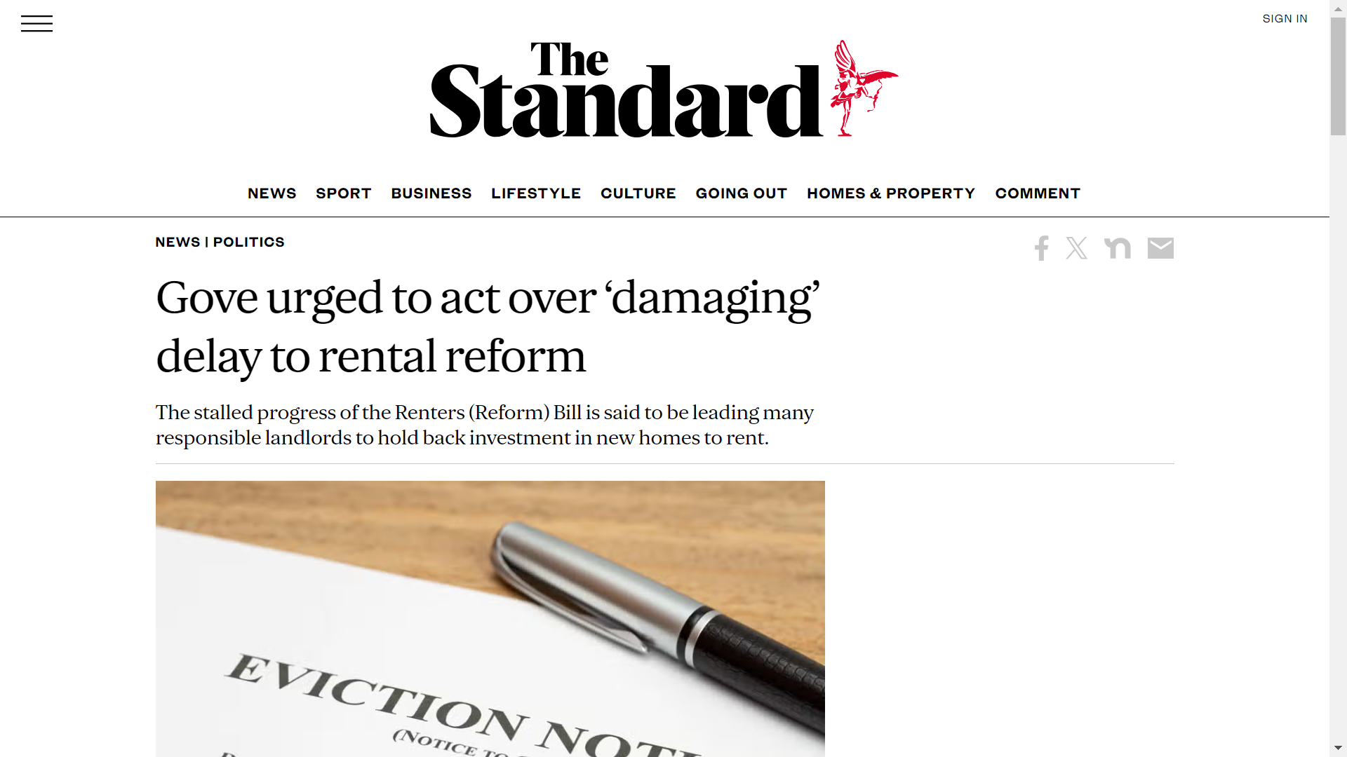
Changes afoot?

Slide 14
What changes are being reported?
Minimum period a tenant needs to be living in the property – tenant cannot give 2 months notice to leave until they have been in a property for at least four months.
Extending the student ground for possession to one-and-two-bedroom student properties.
Review of the courts which the Government would be compelled to publish.

Slide 15
What next?
Ministers in discussions with backbench MPs about potential amendments.
Once agreed, the Bill will need to complete passage through the House of Commons and then the House of Lords.
Timings are tight given the looming general election.
Even if the Bill was to ‘fall’ it would return under a future Labour Government.

Slide 16
What is Labour proposing for the PRS?
Various changes proposed to the Renters (Reform) Bill.
End section 21 “immediately”.
Longer notice periods.
National landlord register.
Has opposed rent controls.

Slide 17
QUESTIONS?

